Slide 1

HR Analytics
Deepa Saw

Slide 2
HR Analytics
Handling Null values
Checked if there were null values in the dataset.
Replaced ‘?’ to None
Replaced Nan with mean valued for continuous columns
Replaced Nan with most frequent values for Categorical columns.
Datatypes
Checked datatypes of each column and changed datatype for column C2 and C14 to Float

Slide 3
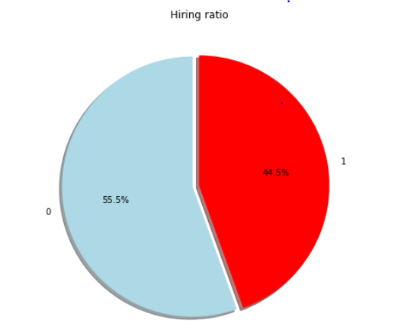
HR Analytics
Since the dataset is balanced ,I did not perform Smoting

Slide 4
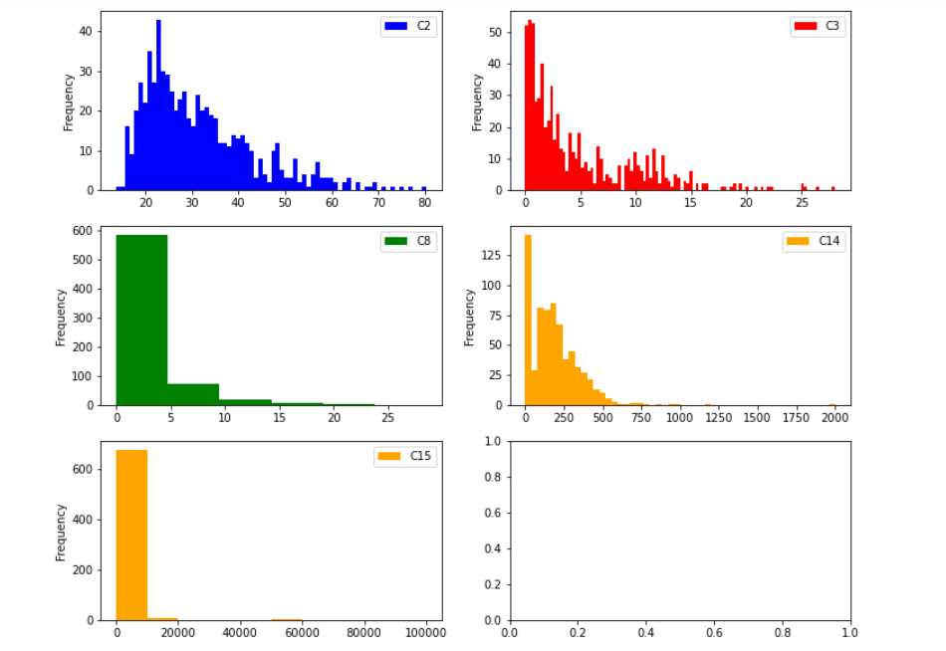
HR Analytics
Checking Outliers for Continuous columns

Slide 5
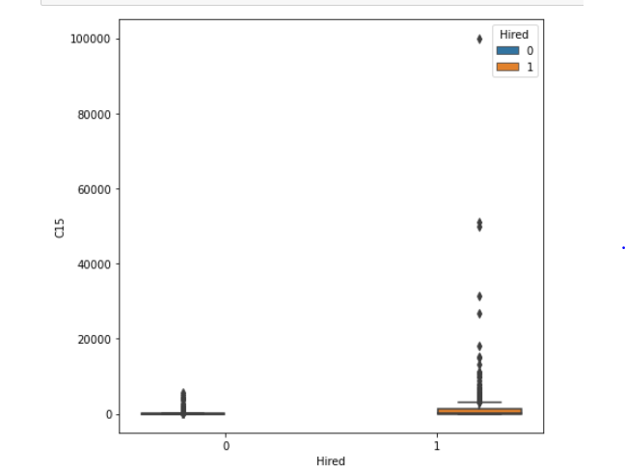
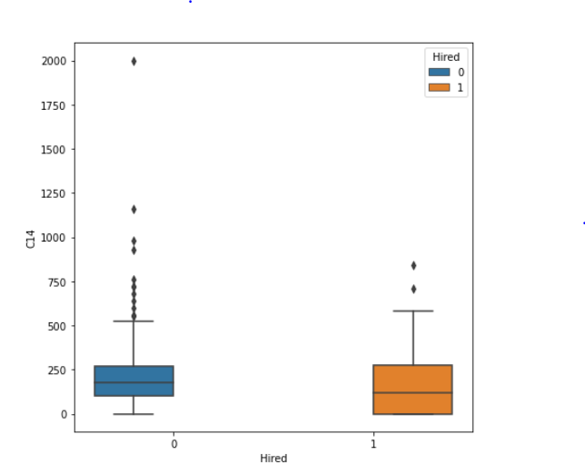
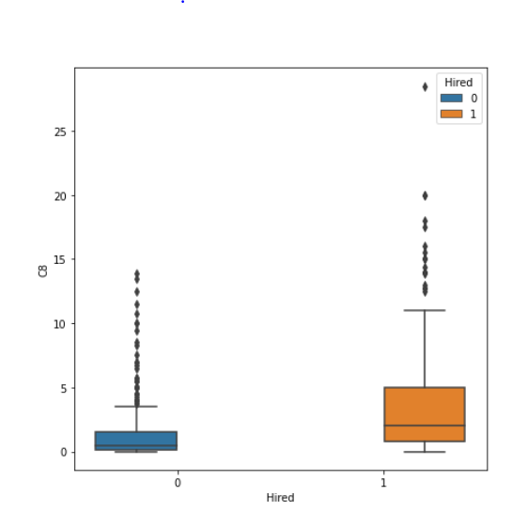
HR Analytics
C15,C14,C8 had Outliers which is evident from the histogram and box plots.(Removed these outliers from dataset)

Slide 6
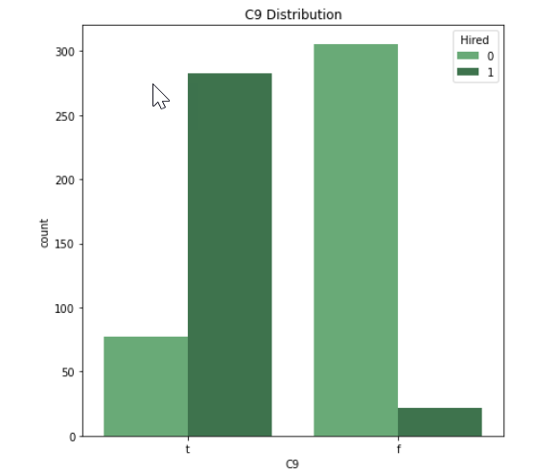
HR Analytics
It is clear from the below bar chart that column C9 has a strong influence on whether a person would get hired or not. Also C9 was selected when I applied SelectFromModel

Slide 7
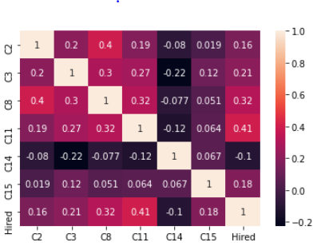
HR Analytics
Checked Correlation metrics for continuous columns.
It is clear from the Correlation matrix that column C11 and C14 are correlated to Hired column(These columns were also selected while using SelectfromModel algorithm)

Slide 8
HR Analytics
As part of preprocessing following steps were done:-
Replacing Null values.
One hot encoding.
Minmax Scaling.(Done on Feature Selection part)
Removing Outliers.
Used Feature Selection technique(SelectfromModel)
Trained 6 classification algorithms once with all the data and then trained them again on columns selected by feature selection algorithm.(Stats are presented in next slide)

Slide 9
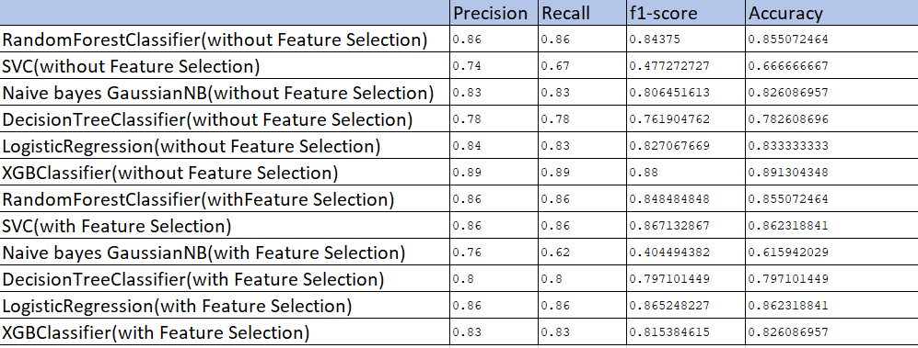
HR Analytics
Comparing all models ,we see that XGBoost Classifier (without Feature Selection ) is working best.
We can further enhance the score by using GridSerachCV /RandomSerachCV.(Shown in Jupyter Notebook).Hence I would select XGBClassifier as my final model.

